Slide 1
THE GURU IN SIKHISM
The way of religion,
TEJA SINGH

Slide 2
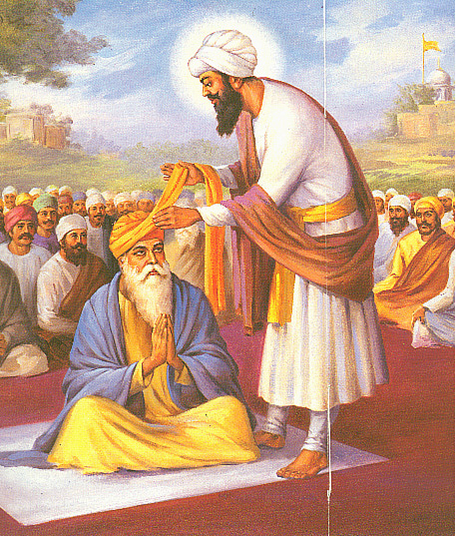
The way of religion, as shown by Sikhism, is not a set of views or doctrines, but a way of life lived according to a definite model.
It is based, not on rules or laws, but upon discipleship.
In the career of the disciple the personality of the Guru is all along operative, commanding his whole being and shaping his life to its diviner issues.
Without such a personality there would be no cohesion, no direction in the moral forces of society, and in spite of a thousand kinds of knowledge ‘there would still be utter darkness.’
Robe of honour being given to disciple GURU AMARDAS JI

Slide 3
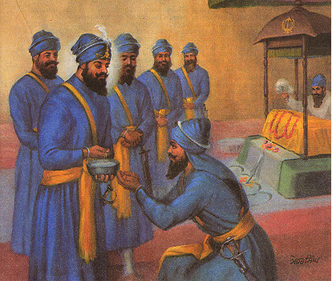
There would be no force to connect men with men and them with God.
Everybody would exist for himself in moral isolation, ‘like spurious sesame plants left desolate in the field with a hundred masters to own them.’
It is the Guru who removes the barriers of caste and position set up by men among themselves and gathering them all unto himself unites them with God.
In the way foundations are laid of a society of the purified who as an organized force strive for the good of the whole mankind.
Laying foundations of a society of the purified who as an organized force strive for the good of the whole mankind.

Slide 4
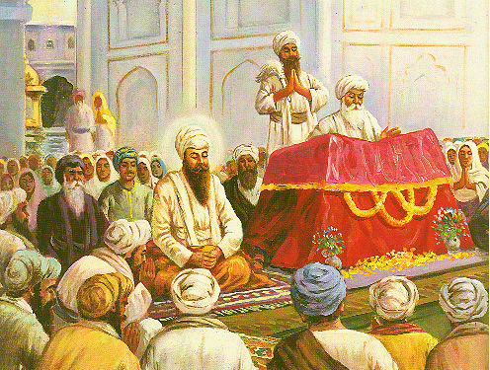
Such a creative personality must be perfect, because ‘men take after whom they serve.’
If the ideal person is imperfect, the society and its individuals following him will also get imperfect development.
But ‘those who serve the saved ones will be saved
The Sikh Gurus were perfect, and are described as such in the Sikh Scriptures.
Guru Nanak himself says in Sri Rag: “Everybody else is subject to error, only the Guru and God are free from error.”
The state of perfection attained by the Gurus is lucidly described in the eighth and the eighteenth octaves of Guru Arjan’s Sukhmani.
Guru Arjun says in Bhairon: “Whoever you meet suffers from vices; without any defect is my true Guru, the Yogi.”

Slide 5
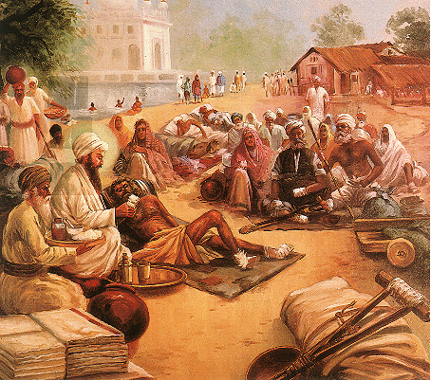
The Guru is sinless.
In order, however, to be really effective in saving man, he must not be above man’s capacity to imitate, as he would be if he were a supernatural being.
His humanity must be real and not feigned.
He should have a nature subject to the same laws as operate in the ordinary human nature, and should have attained his perfection through the same Grace as is available to all men and through perfect obedience to God’s Will.
Guru Arjan dev ji serving lepers

Slide 6
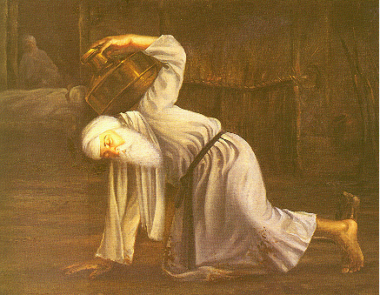
The Sikh Gurus had fought with sin and had overcome it.
Some of them had lived for a long time in error, until Grace touched them and they were perfected through a constant discipline of knowledge, love and experience in the association of their Gurus.
When they had been completely attuned to the Will divine and were sanctified as Gurus, there remained no defect in them and they became perfect and holy.
Thereafter sins did come to tamp them, but they never gave way and were always able to overcome them.
It is only thus that they became perfect exemplars of men and transformed those who came under their influence to veritable angelic beings.
Guru Amardas served Guru ANgad dev ji with utmost devotion

